Slide 1

SQL ANALYSIS PIZZA SALES
www.slidesgo.es
FOR PIZZA WEEK
SWATHI VANGA

Slide 2


INTRODUCTION
In today’s competitive food industry, understanding sales patterns and customer preferences is crucial. This project leverages SQL to analyse pizza sales data, to uncover strategic decision-making.

Slide 3

OBJECTIVES
ANALYSIS
Analyse sales performance
Customer Insights
Product Analysis
Revenue and sales
Regional Impacts

Slide 4

DATABASE TABLES
01
02
03
04
ORDER_DETAILS
ORDERS
order_details_id, order_id,pizza_id,quantity
order_id,order_date, order_time
PIZZA_TYPES
PIZZAS
pizza_type_id, name, category, ingredients
pizza_id, pizza_type_id, size,price

Slide 5

FROM DOUGH
TO DATA

Slide 6

LOVE
PIZZA

Slide 7
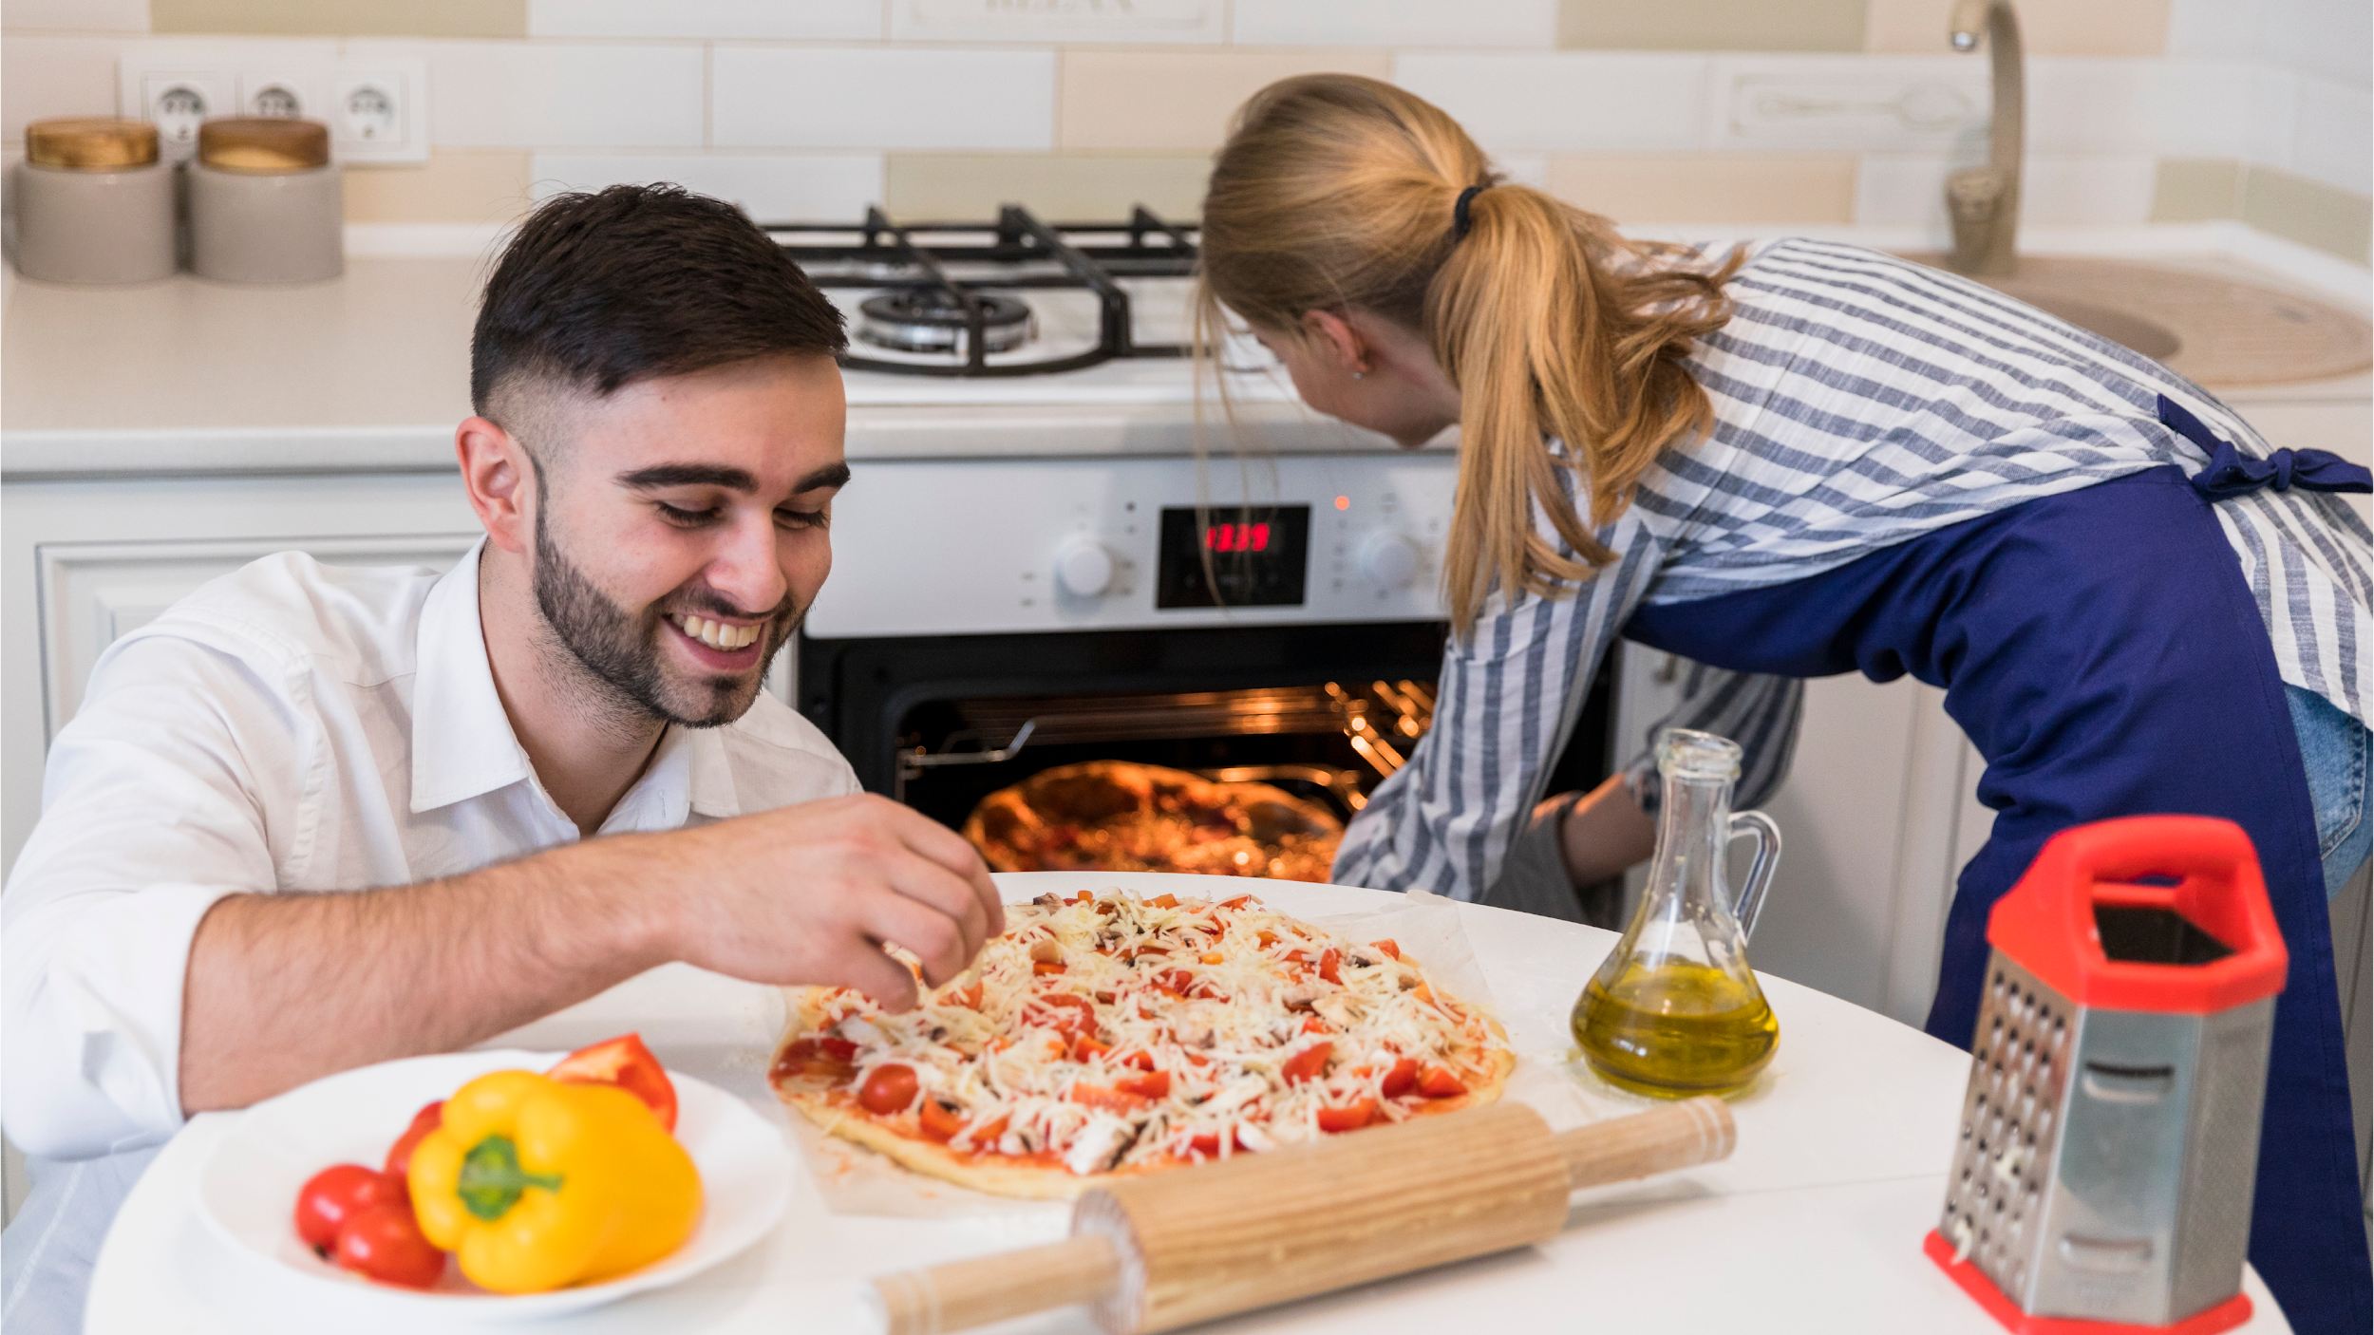
CHEESE, CRUST,
CUSTOMER INSIGHTS

Slide 8
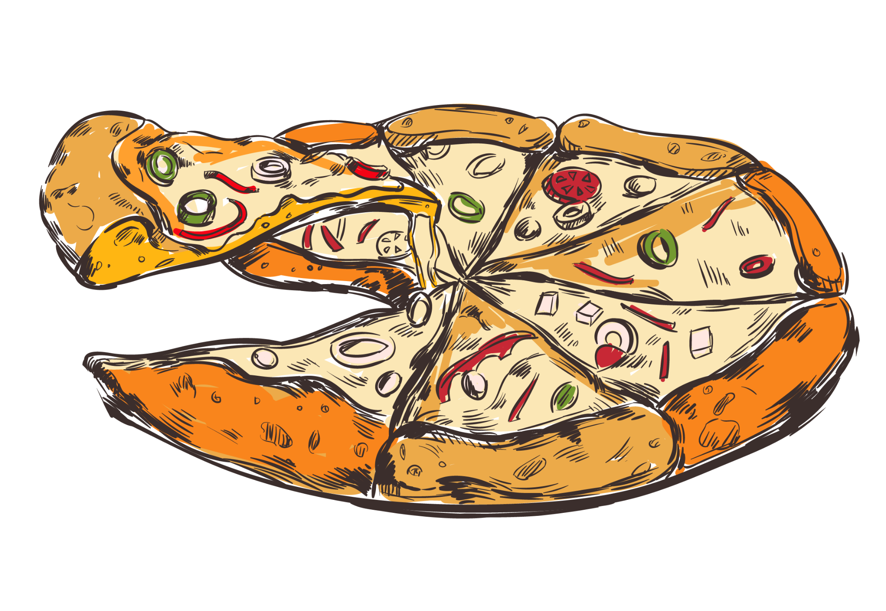

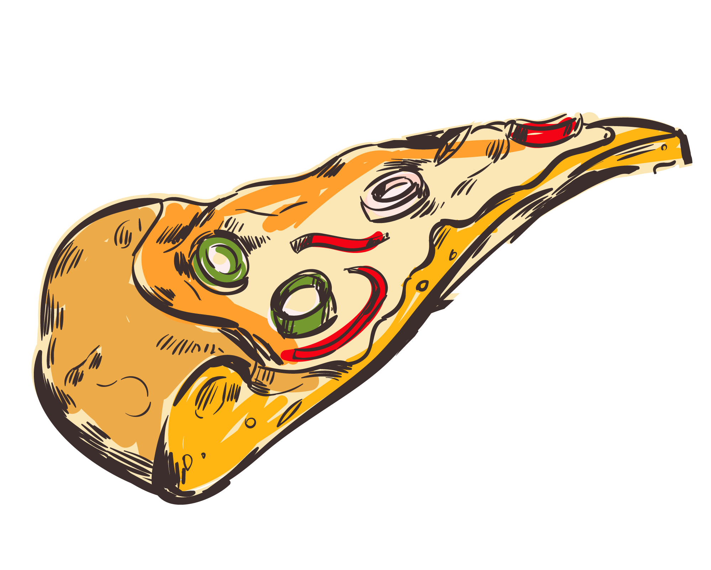




ANALYSIS OF SALES
QUERIES: THE ANALYSIS FOCUS ON SALES OF PIZZA

Slide 9

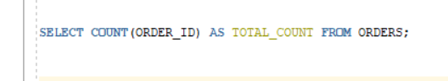

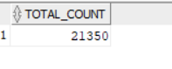
Retrieve the total number of orders placed
QUERY:
Output:

Slide 10
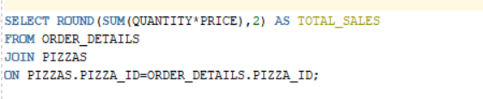
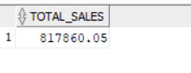
Calculate the total revenue generated from pizza sales
QUERY:
Output:

Slide 11
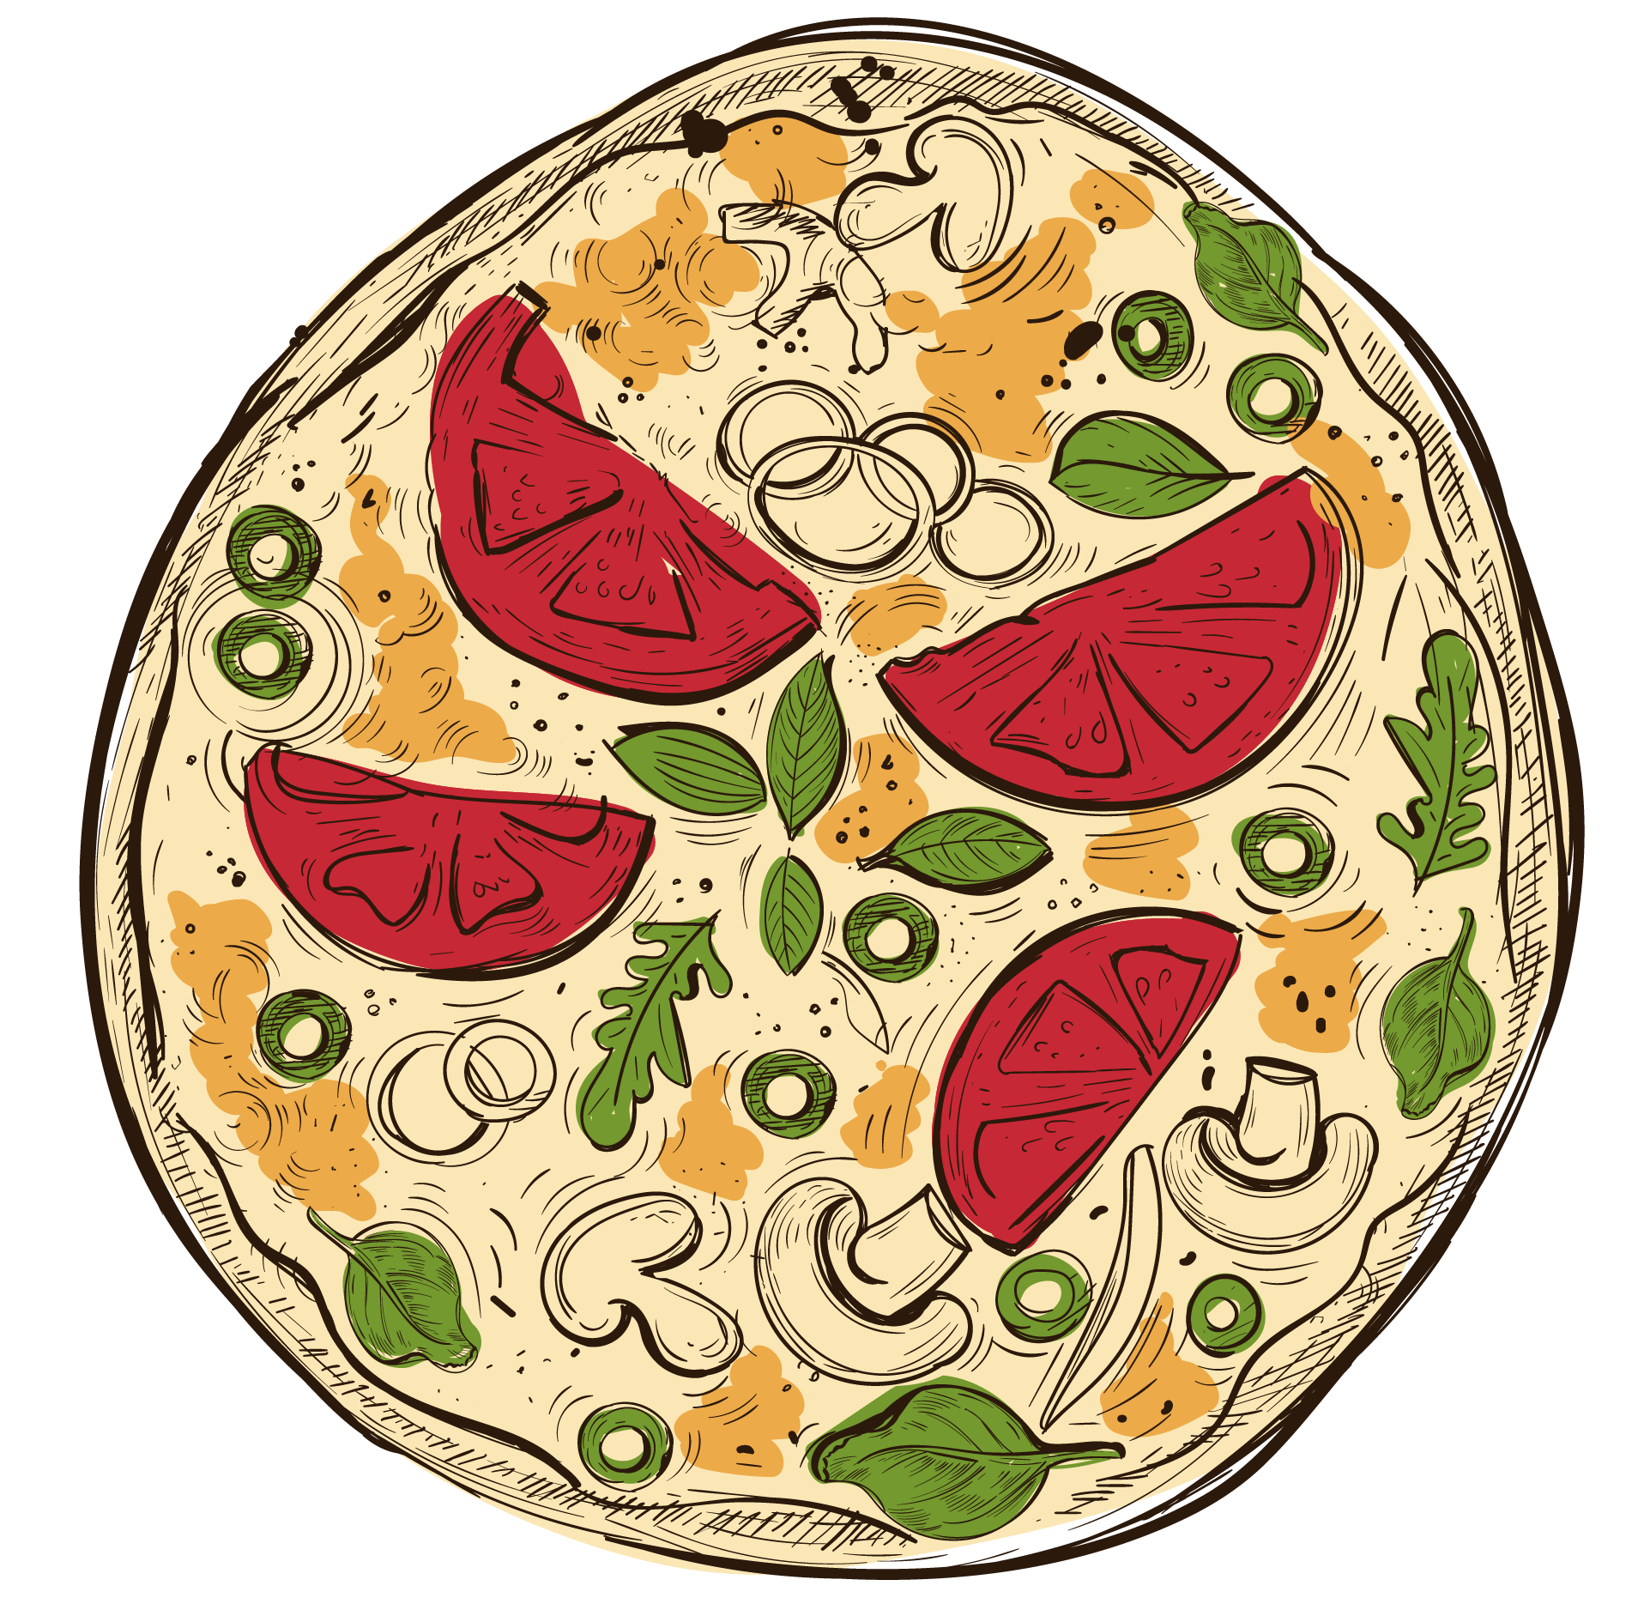
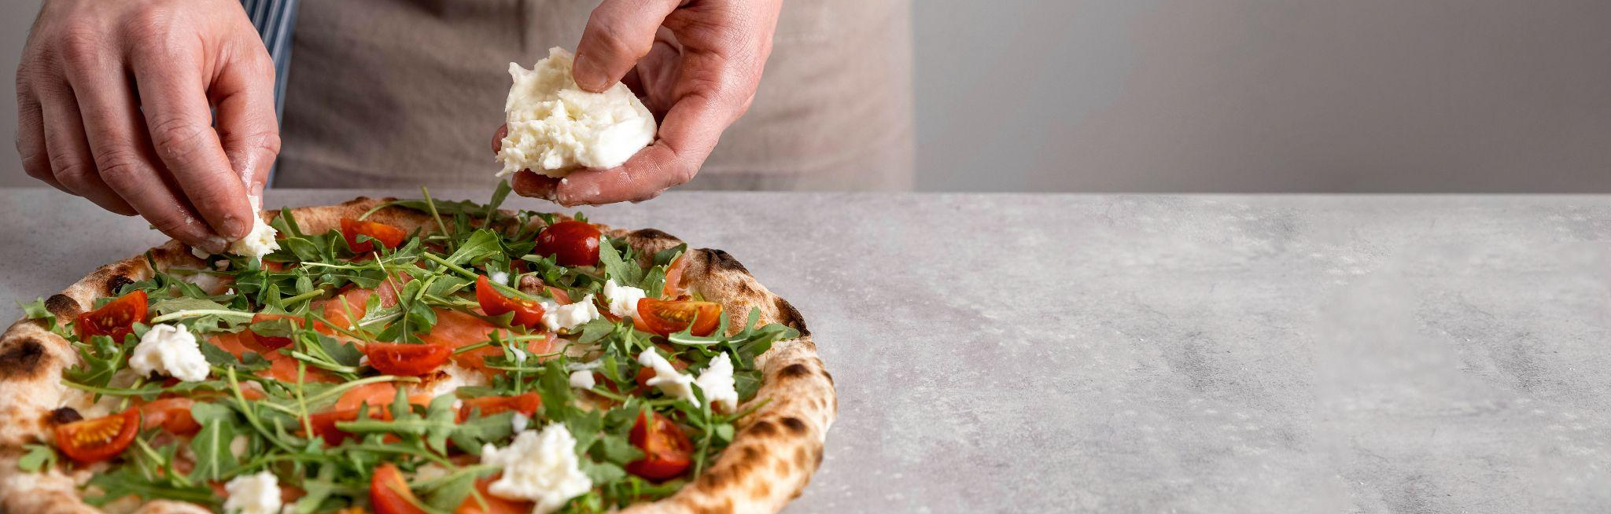
PIZZA SALES OF THE WEEK!!!
THIS WEEK HAS HIGHEST -817806 SALES

Slide 12
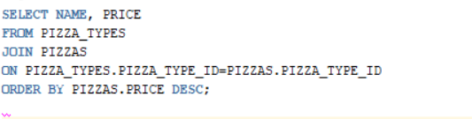
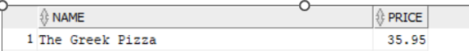
Identify the highest-priced pizza
QUERY:
Output:

Slide 13
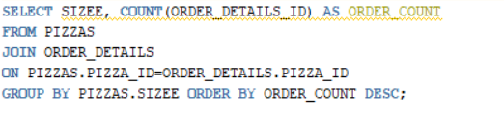
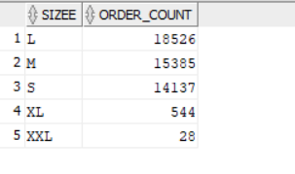
Identify the most common pizza size ordered
QUERY:
Output:

Slide 14
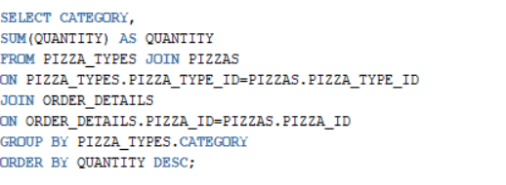
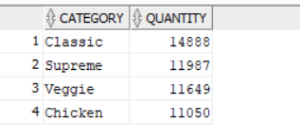
Join the necessary tables to find the total quantity of each pizza category
QUERY:
Output:

Slide 15
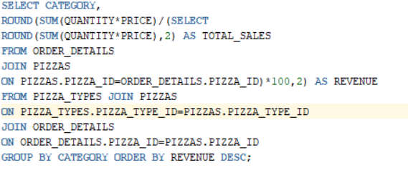
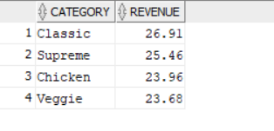
Calculate the percentage contribution of each pizza type to total revenue
QUERY:
Output:

Slide 16

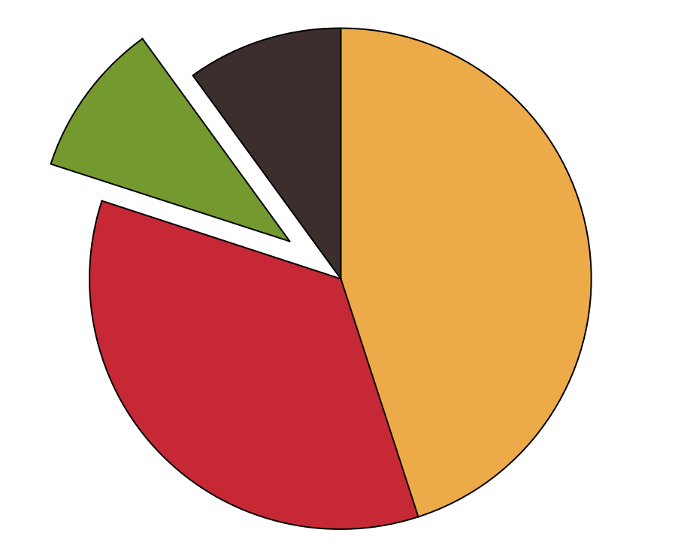
COMPOSITION OF PIZZA
26%
23%
CLASSIC
CHICKEN
PANEER, PEPPRY
SPICY CHICKEN, RED CHILLIE
25%
23%
SUPREME
VEGGIE
TOMATO,ONION,
CAPSICUM

Slide 17
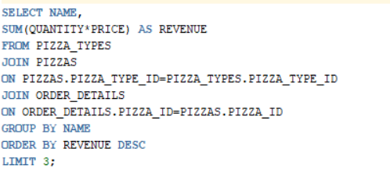
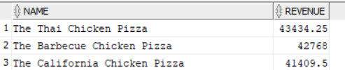
Determine the top 3 most ordered pizza types based on revenue
QUERY:
Output:

Slide 18
MOST ORDERED PIZZA BASED ONREVENUE
03
02
01
CALIFORNIA CHICKEN
BARBECUE
41409.5
REVENUE
THAI CHICKEN
42768
REVENUE
43434.25
REVENUE

Slide 19
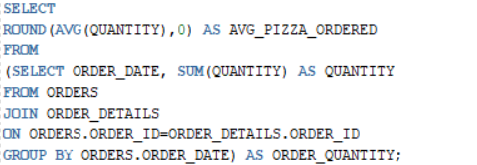
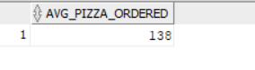
Group the orders by date and calculate the average number of pizzas ordered per day
QUERY:
Output:

Slide 20
THANKS!
Do you have any questions?
swathivanga0313@gmail.com
Swathi Vanga

